Slide 1

Mental Maths at Eynesbury
Parent Information Session
October 2022

Slide 2
We will be focusing on:
What we mean by Mental Maths and why we need to practice it.
What are we doing in school to help children improve their Mental Maths.
How you can help at home.

Slide 3
What do we mean by Mental Maths and Why do we need it?
Mental maths is where we work out calculations in our head (we often use what we know to take short cuts) and we arrive at the correct answer in an efficient way.
For example: 34 x 5
Pupils could mentally calculate (30 x 5 + 4 x 5 = 150 + 20 = 170)
They could also calculate 34 x 10 (340) and then half it to get to 170.
Mental maths strategies are the foundations for most of the areas of mathematics that use numbers. Without efficient mental strategies, children can often struggle to quickly and fluently calculate.
Mental Maths doesn’t mean you don’t write anything down, but any written work would be quick jottings.
In school we need children to be able to recall known facts and use and apply these facts quickly within other problems.
Notes:
Talk about Year 6 SATs but also how Maths is all around us in the world and we use it often without even realising.

Slide 4
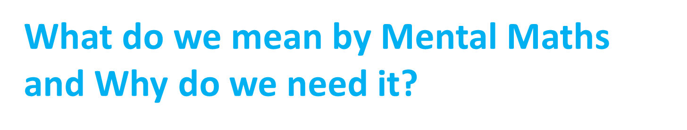
“Understanding how to make links is as important as memorising the facts” (Julia Anghileri, Teaching Number Sense, 2000).
Love it or hate it, Maths is in the world all around us. It is as much part of life as reading is.
As you know, pupils need to practice reading regularly before they are efficient and fluent, in just the same way pupils need to practice recalling maths facts regularly to become efficient and fluent.

Slide 5
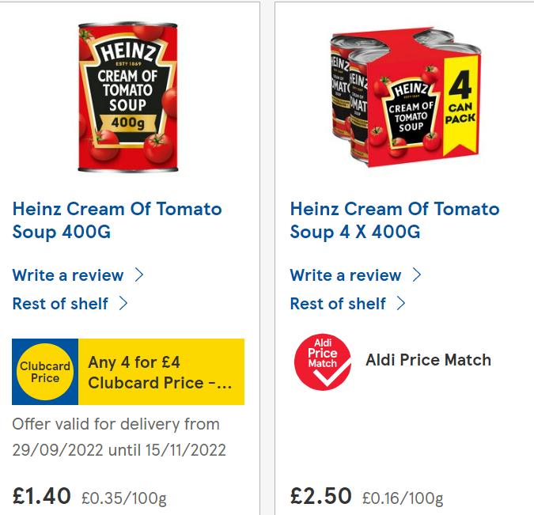
Some examples of where we use maths in our everyday lives:
Estimating or calculating exactly how much time things take eg to get ready to go out/get to school on time or how long left in a football match?
Shopping – using money to pay/check change/ work out the best deals.
Cooking – not just weighing and measuring but also working out different timings so dinner is all ready at the same time.
Notes:
Talk about fun fair and not being given the correct change

Slide 6
What are we doing in school to improve Mental Maths?
MARS MATHS
In class daily the pupils are completing MARS maths sessions.
Three times a week they will be recalling key learning from previous weeks/terms/years in a ‘4 a day’ session.
Twice a week (as a minimum) we will be focused on recalling facts linked to the year group MARS Maths target.
Year 1: Number bonds to 10
Year 2: Count on in 1’s from any number/ read and write all numbers to 100.
Year 3: Recall facts for 2x/5x and 10x tables and the related division facts.
Year 4: Recall facts for 2x/ 3x/ 4x/5x/ 8x and 10x tables and the related division facts.
Year 5: Recall facts for all tables to 12 x 12 and the related division facts.
Year 6: To find factor pairs for numbers to 100/ know my prime numbers to 100.
These MARS maths targets will change every half term.

Slide 7
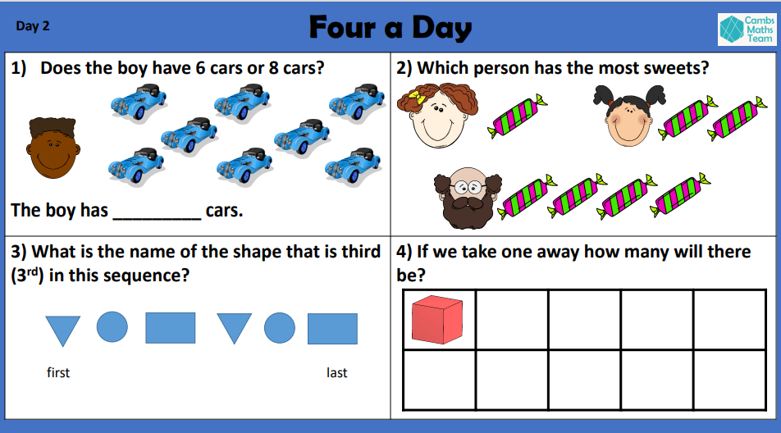
Notes:
Year 1

Slide 8
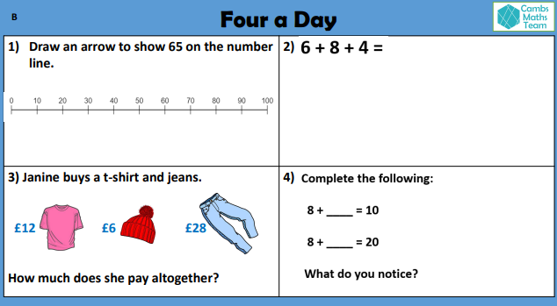
Notes:
Year 3

Slide 9
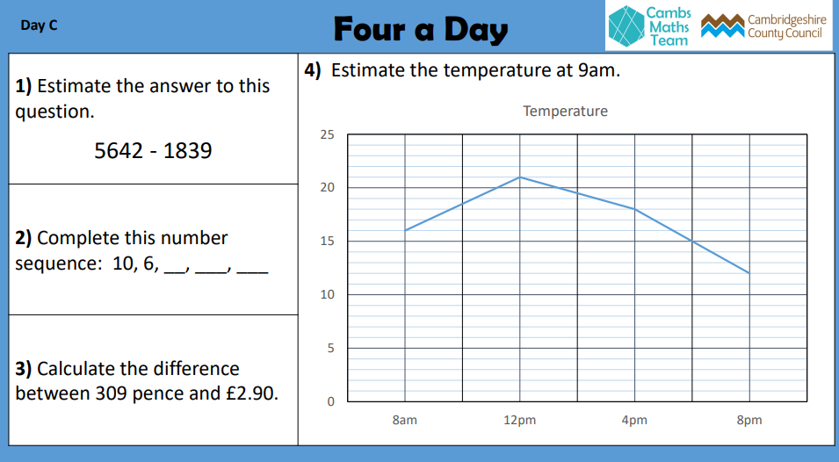
Notes:
Year 5

Slide 10
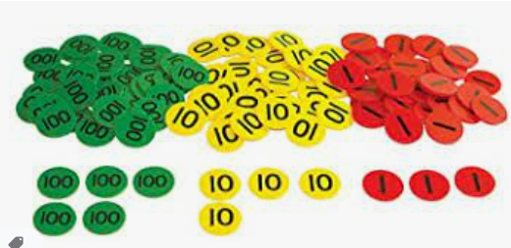
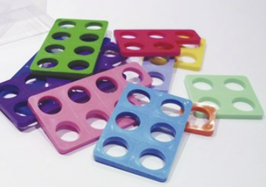
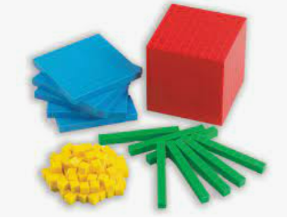
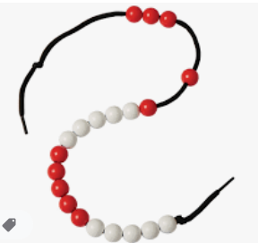
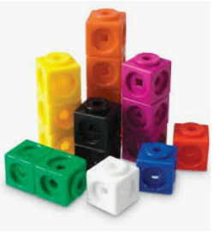
What are we doing in school to improve Mental Maths?
Although pupils will be learning more and more maths facts which they can instantly recall it is vital that they understand the concepts. We start by teaching the concepts using manipulatives, moving to virtual manipulatives on the interactive whiteboard when the numbers get too big to physically hold.
Once pupils are secure with concepts we move on to help them begin to learn these as facts to recall.

Slide 11
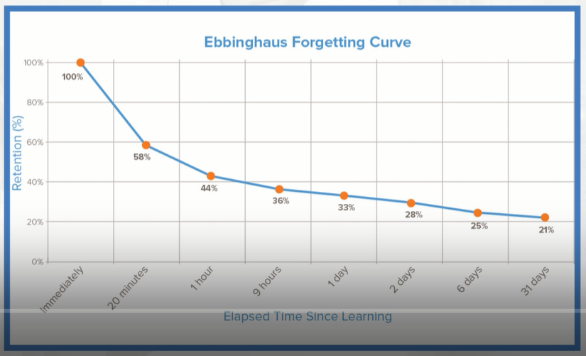
Ebbinghaus Forgetting Curve

Slide 12
Ebbinghaus Forgetting Curve
A suitable distribution of repetitions over a space of time is decidedly more advantageous that the massing of them at a single point.
(Ebbinghaus)

Slide 13
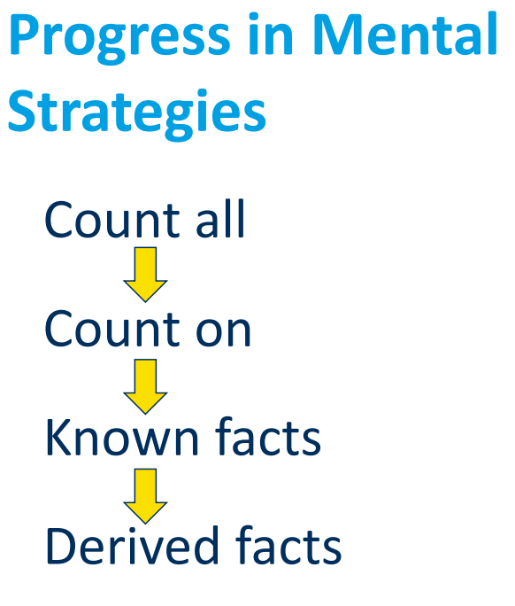
What are we doing in school to improve Mental Maths?
In Early Years pupils begin by counting everything. If we give them two piles of cubes, they will count them all to find the total.
We then progress pupils to knowing that they don’t need to count them all, they can count on eg 4 + 3, start at 4 and count on 3.
We aim for them to learn number bonds facts to 20 + 20 by the end of KS1, so they will know that 4 + 3 is 7 and there is no need to count anything.
Then they can use this fact to work out others eg
40 + 30
or 54 + 3
or 67 – 34 (using the original 4 + 3 related fact of 7 – 4 = 3)
Notes:
Remind them pupils need to be able to count on or back from any number for the count on stage, we often find that pupils can only count on from 1 or 0.

Slide 14
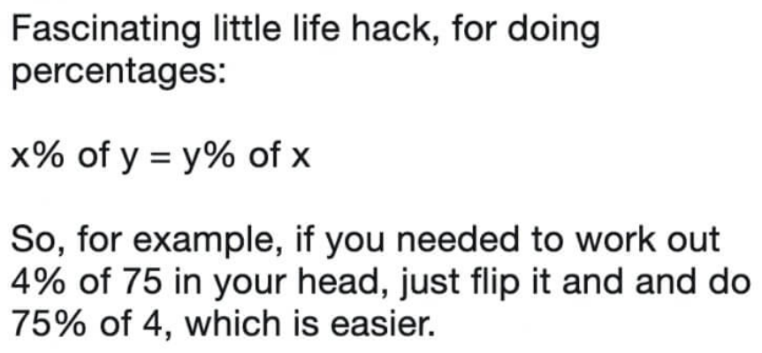
We will teach facts, but also tips for learning those facts such as quick little rhymes: 6 eights are what I hate 48.
Or to find 4x, double 2x:
4 x 15 (double 15 = 30, double 30 = 60)

Slide 15
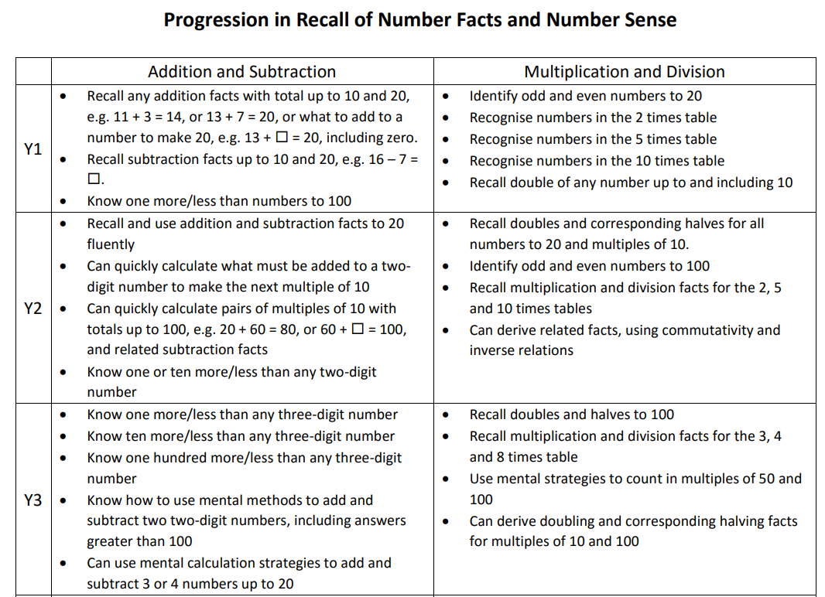

Slide 16
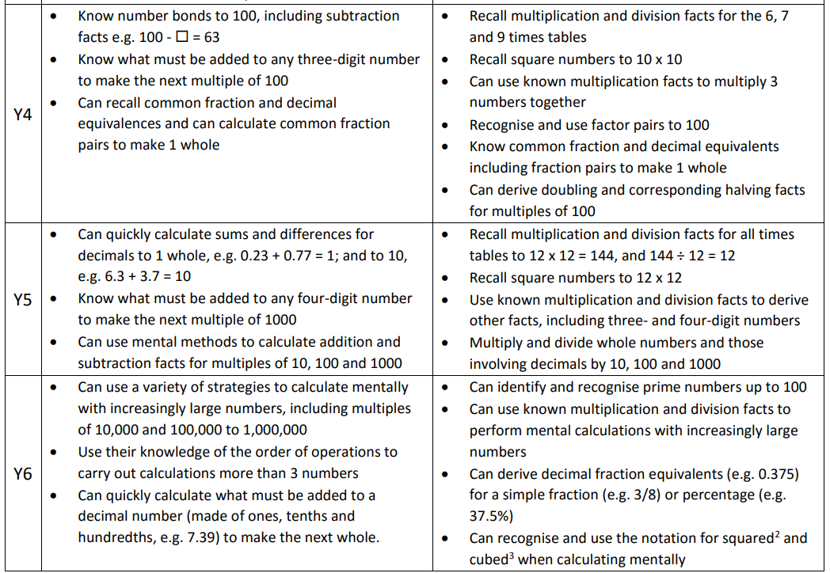

Slide 17
Why is this our focus this year?
Our pupils are working too hard!
We discovered last academic year that many of our pupils are able to solve complex problems, but they are not using the most efficient methods to get there. They were counting rather than calculating or using longer complex methods as they were not spending time looking at the calculation and seeing what they noticed.
This year we are working with the children to ensure that they take a few moments to look at the question and not rely on written methods that will take longer than is needed.
eg
24 + 35 + 16 = 24 + 16 = 40 + 35 = 75
47 + 59 – 37 = 47 – 37 = 10 + 59 = 69
Spending time looking at all the numbers means we spot patterns and realise that we can quickly and efficiently calculate mentally, often quicker than we can type it into a calculator!

Slide 18
How can I help at home?
From Pre-school age playing board games such as snakes and ladders, monopoly (inc junior monololy) will support your child. (skills used include subitising, counting , 1:1 correspondence, learning to add)
When your out and about look at number patterns on doors for example (counting in 2’s, knowing what number comes next)
Use apps/websites to play games
Talk to your childs class teacher – if you need help, more ideas to support or extend – we’re here to help!
Practise the MARS maths targets sent home

Slide 19
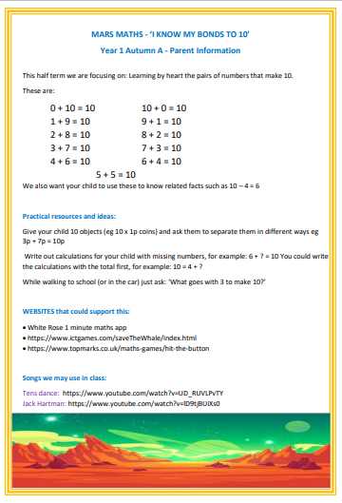
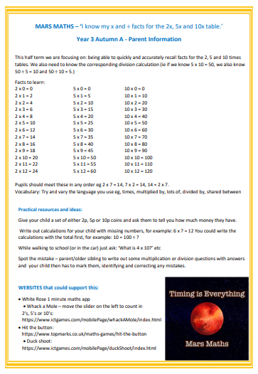
How can I help at home? MARS MATHS
Notes:
Add in challenge, if they know 4 + 6 = 10, can they say 14 + 6 = 20 or 4 + 16 = 20, equally if they know 2 x 7 = 14, can they say 2 x 70 = 140?

Slide 20
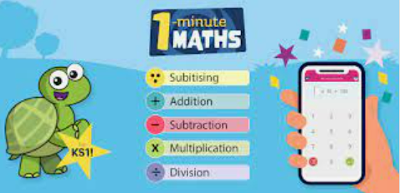
How often do we need to help?
As often as you can, remember the Ebbinghaus curve? The more you do it the easier it is to recall, so little and often is our mantra!

Slide 21
Any
Questions?

