Slide 1
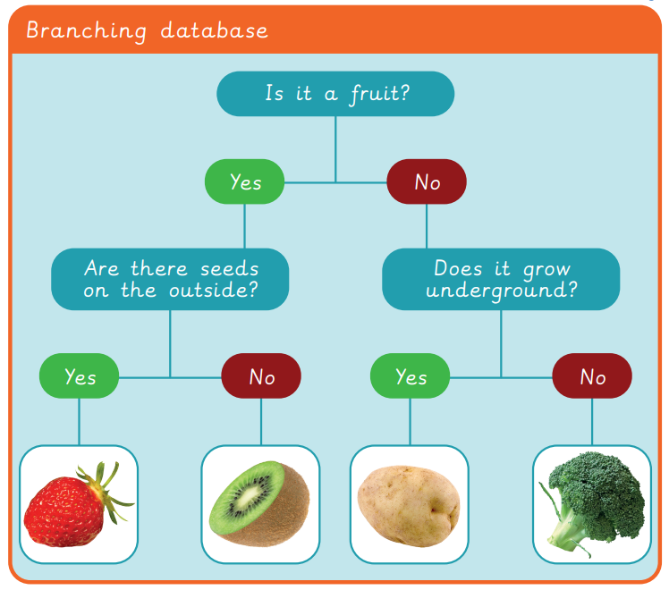
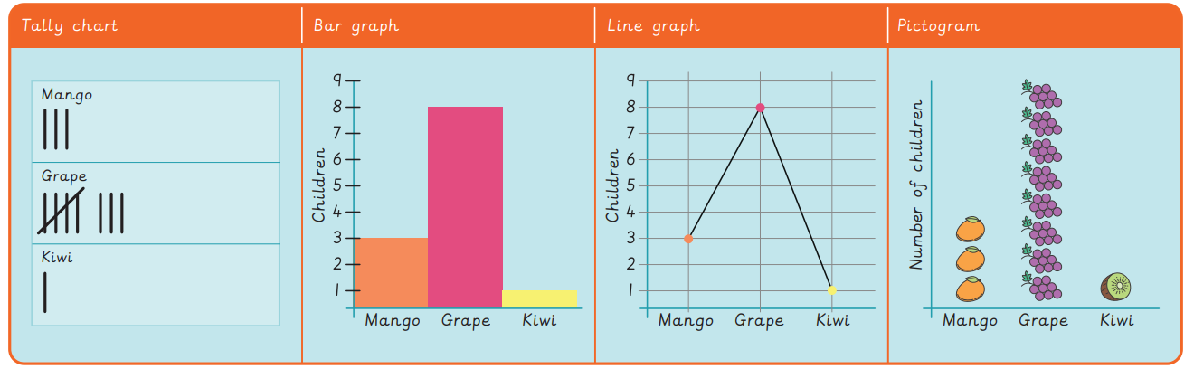
EYNESBURY KNOWLEDGE ORGANISER
KEY WORDS AND FACTS
VOCABULARY
Branching database- Using a series of yes or no questions to categorise data or objects.
Categorise- Put into groups that have similar or the same properties.
Chart- Information displayed in a graph, table, tally or diagram.
Computer- Electronic machine that accepts and processes information to produce an output.
Data- Information used for a specific purpose or investigation.
Information- Facts about a specific thing, person, place or other.
Label- Information attached to something to tell you about it.
Pictogram- A chart which uses pictures to represent items.
Record- To store information about something.
Sort- To arrange items by an order or into a category.
Table- A chart which stories data in columns and rows.
Fact Bank
YEAR 1: Data handling- introduction to data

