Slide 1
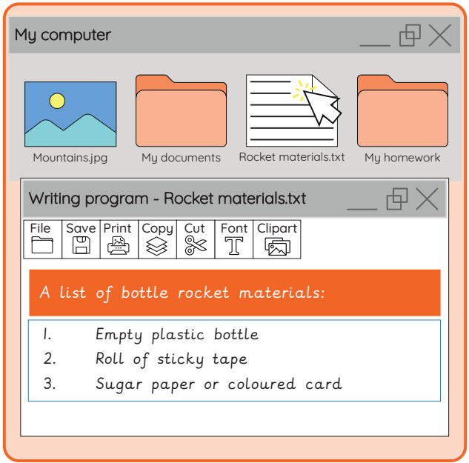

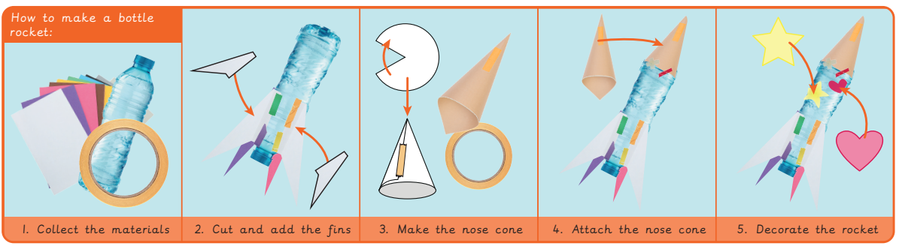
EYNESBURY KNOWLEDGE ORGANISER
KEY WORDS AND FACTS
VOCABULARY
Digital content- Information and media such as videos and pictures stored on a computer.
Computer program- A series of instructions, that are written for a computer to follow. Also known as apps.
Create- To make something.
Computer- Electronic machine that accepts and processes information to produce an output.
Data- Information used for a specific purpose or investigation.
E- Document- An electronic file which includes text.
Folder- An electronic storage file that holds other digital content for example text, pictures and videos.
List- A number of things, one after the other.
Sequence- A set order or pattern for something to follow.
Share- To show or give a part of something to someone else.
Spreadsheet- An electronic document that lets you store data in rows and columns.
Fact Bank
YEAR 1: Skills showcase- Rocket to the Moon

