Slide 1
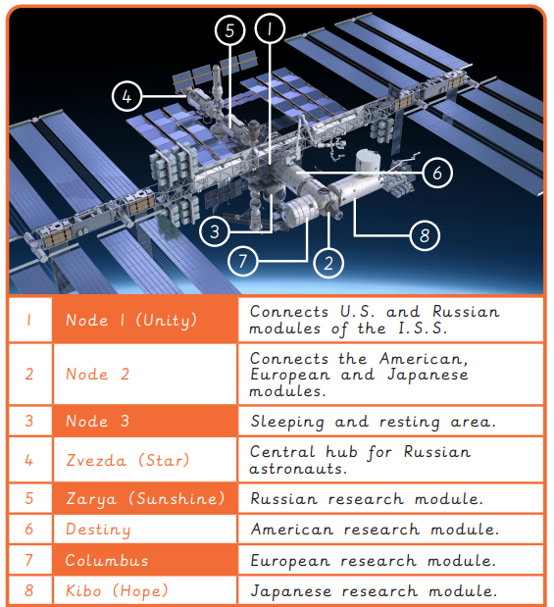
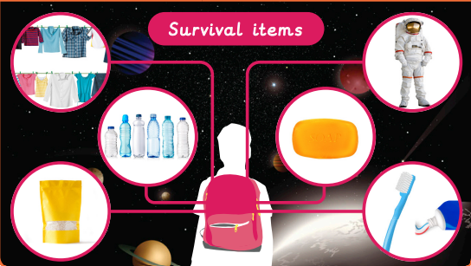
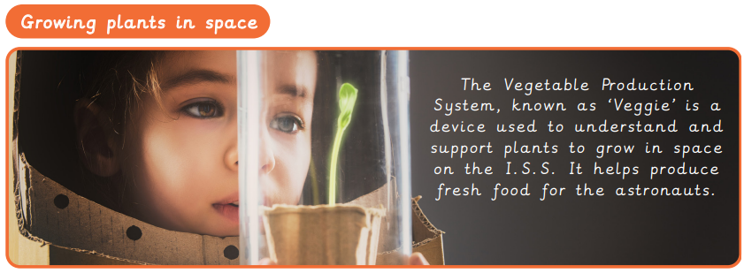
EYNESBURY KNOWLEDGE ORGANISER
KEY WORDS AND FACTS
VOCABULARY DOZEN
Approximate- Being close but not exactly the same as something.
Astronaut- Someone who is trained to control a spacecraft.
Data- Information used for a specific purpose or investigation.
Digital content- Information and media such as videos and pictures stored on a computer.
Experiment- To trial and test new ideas.
Interactive map- A digital map which can be searched and provide information about a place.
International Space Station- I.S.S a laboratory in space that obits the Earth.
Interpret- Explain the meaning of something to someone else or to yourself.
Laboratory- A place where scientists carry out research and experiments to discover more about something.
Monitor- To check the status of something.
Satellite- A computer that orbits the Earth to provide information or communication services.
Sensor- A tool or device that is designed to monitor, detect and respond to changes.
Fact Bank
YEAR 2: Data handling- International Space Station

