Slide 1
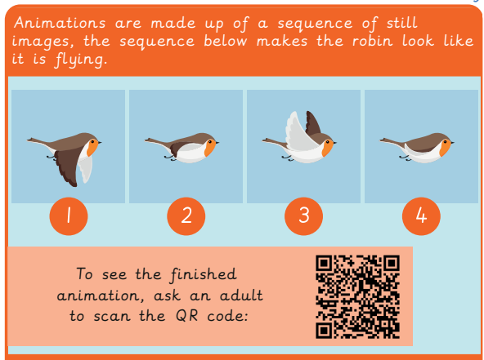
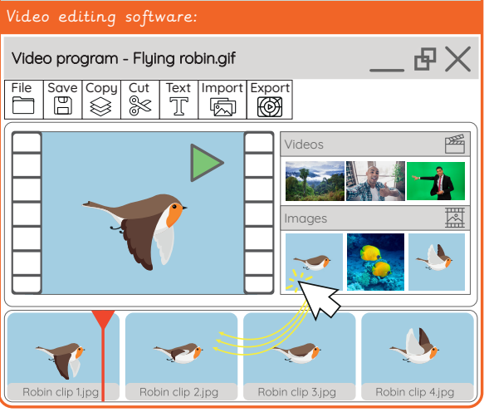
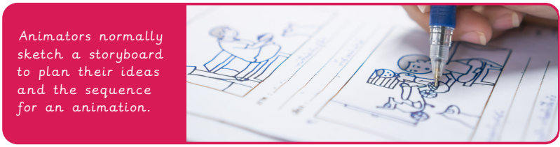
EYNESBURY KNOWLEDGE ORGANISER
KEY WORDS AND FACTS
VOCABULARY DOZEN
Animation- Pictures or photographs in a sequence to give the illusion of movement.
Contraption- An old- fashioned device.
Decompose- To break something down into smaller chunks.
Design- To make, draw or write plans for something.
Device- Equipment created for a certain purpose or job.
Download- Saving files from the internet, intranet or another device.
Import- To place a picture into a document or into other software.
Sketch- A rough drawing to help you plan.
Software- A series of instructions written for a computer to follow.
Stop motion- A sequence of photographs used to create an animation.
Storyboard- A sequence of sketches that show what you plan to make an animation or video.
Upload- To send files from one device to another.
Did you know?
YEAR 2: Creating Media- Stop Motion

