Slide 1
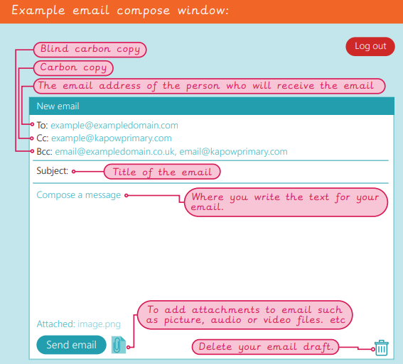
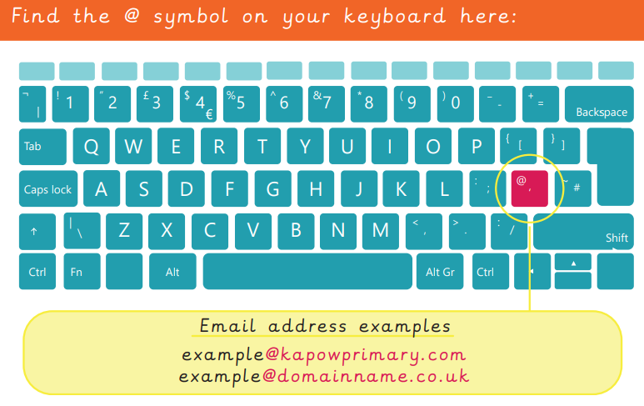

EYNESBURY KNOWLEDGE ORGANISER
KEY WORDS AND FACTS
VOCABULARY DOZEN
Account- an online or intranet service, which stores information safely using a username and password.
Attachment (email)- a function that lets you add files to an email.
BCC- blind carbon copy lets you send a copy of an email written to another person’s email, but other readers cannot read the email thread.
CC- carbon copy lets you send a copy of the email you have written to another person’s email address.
Cyberbullying- bullying through the internet/ electronic devices.
Domain- the online location or hosting website an email address belongs to.
Email account- a central place where a user’s emails are stored for them to view.
Emoji- small icons that represent feelings or objects.
Log on/off- put in a username and password to access a personal account and to lock your account.
Username- a unique name or email address for your account.
Password- a unique combination of letters, numbers or symbols to protect an account.
Spam- nonsense or junk emails, used for advertisement or harassment.
Fact Bank
Watch out for unexpected emails with unknown links! Inform a trusted adult immediately!
YEAR 3: Emailing

