Slide 1
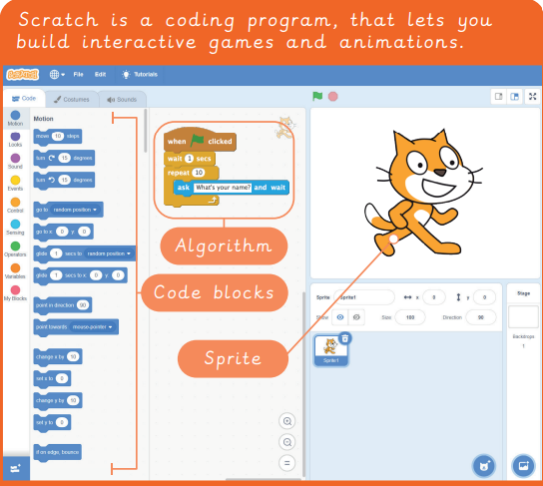
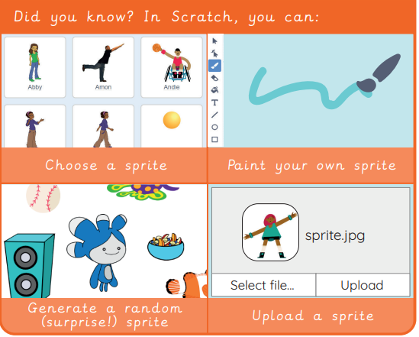
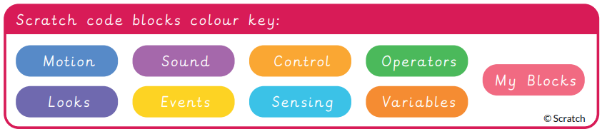
EYNESBURY KNOWLEDGE ORGANISER
KEY WORDS AND FACTS
VOCABULARY DOZEN
Animation- Bringing concepts to life through 2D or 3D moving pictures.
Application- A computer program.
Code- a set of instructions written in programming language, telling a computer what to do.
Debug- To remove and repair the error or mistake in computer code.
Decompose- to break something down into smaller chunks.
Interface- The menus, buttons and other functions which make website or computer program intuitive to humans.
Loop- A repeated series of instructions.
Predict- To make an education guess as to what might happen.
Tinker- To explore and play with something to discover the key functions.
Remixing code- Altering code that already exists.
Repetition code- To create loops in a program, making it more efficient.
Sprite- visual objects that can be manipulated through code.
YEAR 3: Programming- Scratch

