Slide 1
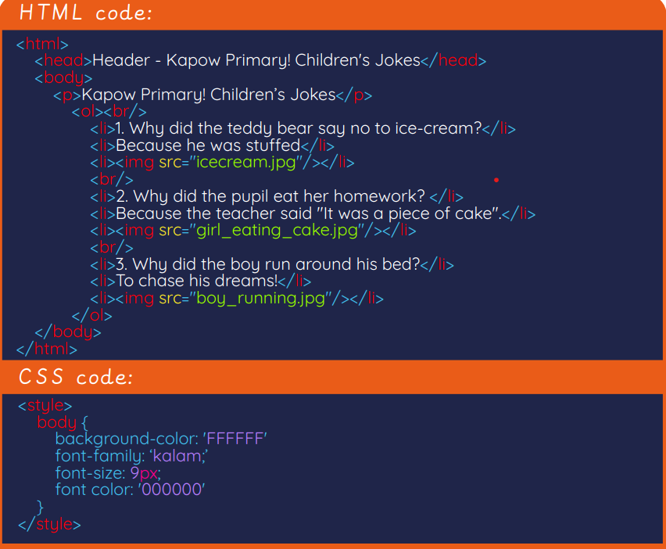
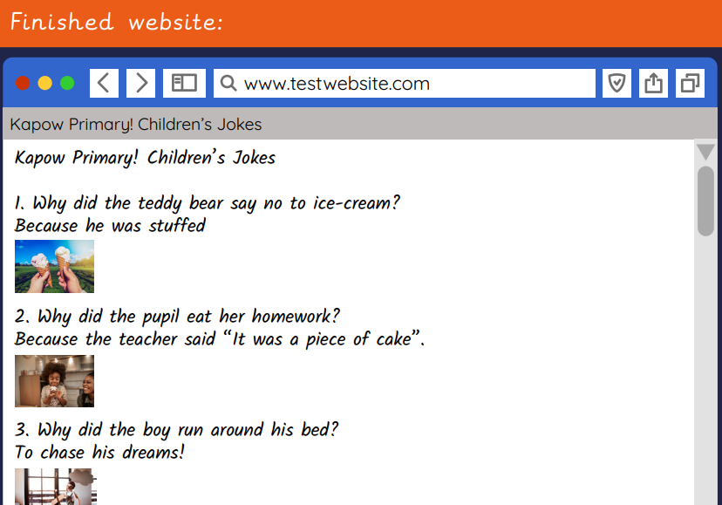
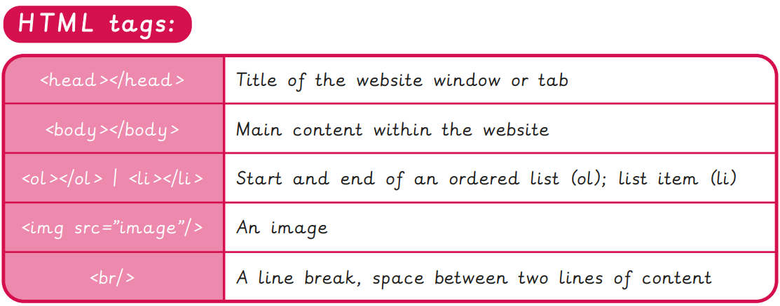
EYNESBURY KNOWLEDGE ORGANISER
KEY WORDS AND FACTS
VOCABULARY DOZEN
Code- To write in programming language.
Content- All information and media contained within something e.g. a webpage.
Copyright- The law which protects other people’s work from being used without permission.
CSS- Cascading Style Sheets are used to layout documents and webpages.
Hacker- Someone who writes malicious software to gain unauthorised access or steal data without permission.
Hex code- Hexadecimal numbering system code, which deals with a combination of 16 characters and digits to represent numbers.
HTML- Hypertext Markup Language used in the creation of electronic pages that can be viewed on the WWW.
Internet browser- Allows you to conduct a search on the WWW, for information and media.
Permission- When someone has given you the right to do something.
Script- A list of computer commands written in a particular programming language.
URL- Uniform Resource Locators are used to identify the address of a WWW page.
Web page- A hypertext page that can be viewed through an internet browser.
Fact Bank
YEAR 4: HTML- Skills Showcase

