Slide 1
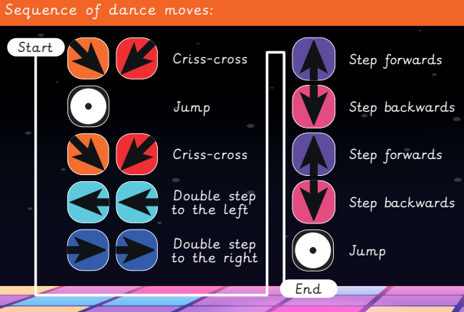
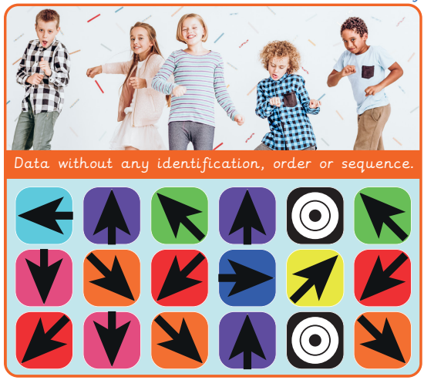
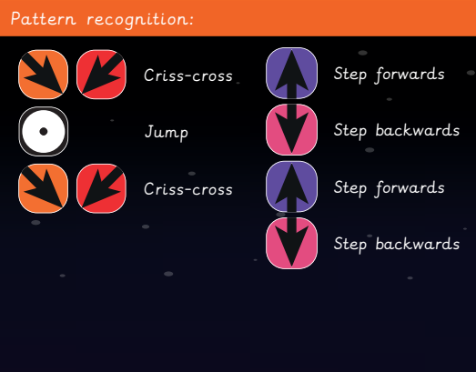
EYNESBURY KNOWLEDGE ORGANISER
KEY WORDS AND FACTS
VOCABULARY
Code- To write in programming language.
Abstraction- Identifying the important detail and ignoring irrelevant information.
Algorithm design- Creating a formula or set of instructions to solve the problem.
Code blocks- A visual representation for a section of code that performs a certain job.
Computational thinking- A method of tackling a complex problem, to devise a solution which both computers and humans can understand.
Computer- Electronic machines that accept and process information to produce an output, and then store the results.
Decompose- To break something down into smaller chunks.
Pattern recognition- Identifying similarities and recurrences in data.
Problem- A matter or situation that needs to be resolved.
Sequence- A set order or pattern for something to follow.
YEAR 4: Computational Thinking

