Slide 1
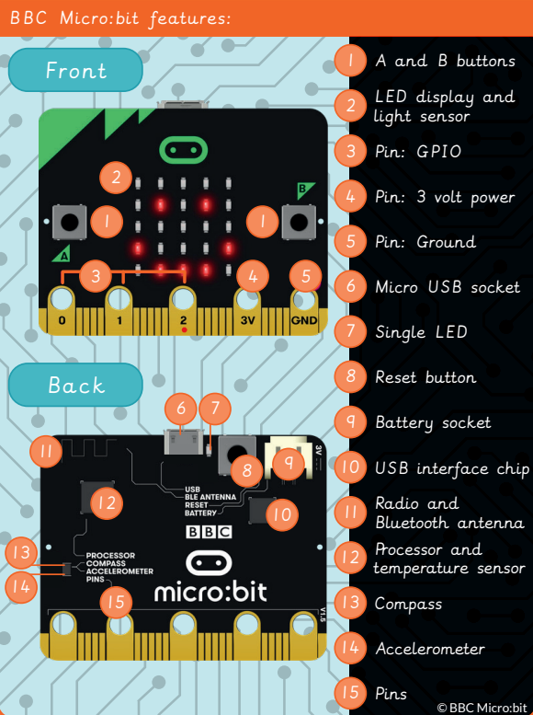
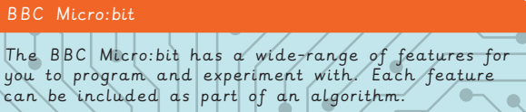
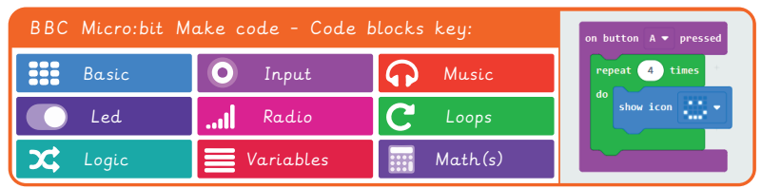
EYNESBURY KNOWLEDGE ORGANISER
KEY WORDS AND FACTS
VOCABULARY DOZEN
.hex file- A file type, that carries binary information.
.zip file- Multiple files that are bound together as a single file, to use less digital storage space.
Bluetooth- Device to device connectivity, for example sharing an image between two smart phones.
Code blocks- A visual representation for a section of code that performs a certain job.
Decompose- To break something down into smaller chunks.
Emulator- A program or machine that is built to copy the way another computer system works.
Feature- Distinctive characteristics of something.
Loop- A repeated series of instructions.
Micro:bit- Created by the BBC, a small compact computer that you can code.
Pedometer- A device used to record the number of steps taken to calculate the distance travelled.
Systematic- Doing something in an ordered way to achieve a specified goal.
Tinker- To explore and play with something to discover the key functions.
Fact Bank
YEAR 5: Programming- Micro:bit

