Slide 1
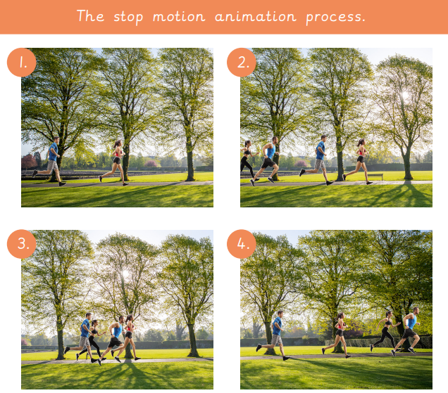
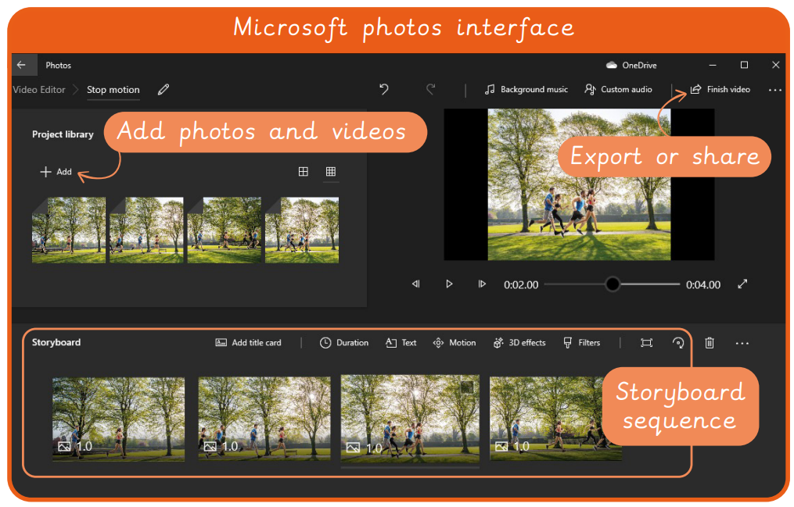
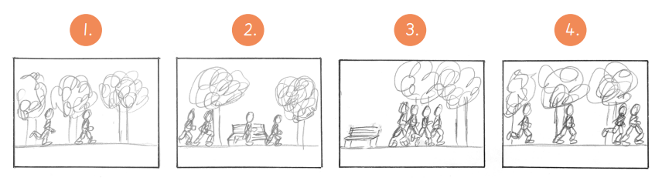
EYNESBURY KNOWLEDGE ORGANISER
KEY WORDS AND FACTS
VOCABULARY DOZEN
Animation- Picture or photographs in a sequence to give the illusion of movement.
Animator- Someone who specialises in the creation of animations.
Background- What can be seen behind the main objects or people in a picture.
Decompose- To break something down into smaller chunks.
Device- Equipment designed for a specific purpose or job.
Duplicate- To make an exact copy of something.
Editing- The process of making changes to a text or film.
Frame- Each picture or page in an animation.
Illusion- Something that is now how it appears to be.
Stop motion- A sequence of images or photographs used to create an animation.
Storyboard- A sequence of sketches to show what will be included within an animation or video.
Upload- To send files from a device to another device or program.
Fact Bank
YEAR 5: Creating media- Stop motion animation

