Slide 1
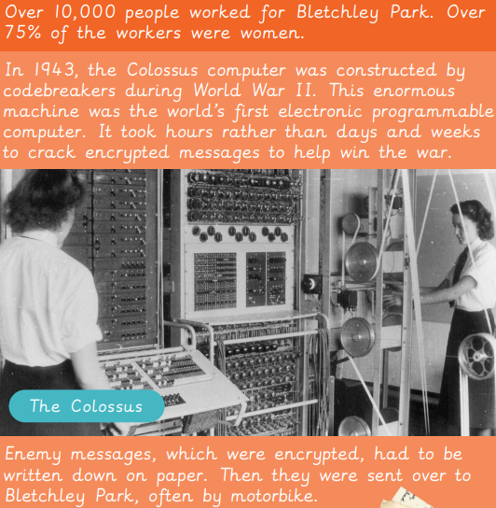
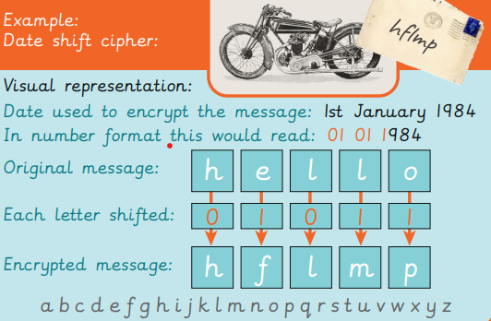
EYNESBURY KNOWLEDGE ORGANISER
KEY WORDS AND FACTS
VOCABULARY DOZEN
Acrostic code- A code where the first letter is each word, line or paragraph when put together form a message.
Brute force hacking- When a hacker uses different methods to crack entry into secured information.
Caeser cipher- A way in which every letter is replaced with another letter a fixed number of places down the alphabet.
Chip and pin- A payment system to buy something securely using a card containing a chip. The car owner can access by entering a Personal Identification Number (PIN).
Cipher- Information that is written in a secret way, also known as a code.
Date shift cipher- A code derived from a date telling you how many spaces to move each letter within a coded message.
Encrypt- Converting information/ data into a secret code or message, to avoid unauthorised access.
Invention- A new device or process that solves a problem.
Nth letter cipher- A code where you choose the Nth letter of the text/ code again until the text ends. If N=10 you will find every 10th letter in the text reveals part of a secret message.
Password- A unique combination of letters, numbers or symbols that protects personal information online.
Pigpen cipher- A substitution code, where letters are exchanged for symbols, which are part of a specific grid.
Technological advancements- When scientific discoveries are made leading to a development in a type of technology.
YEAR 6: Computing systems and networks: Bletchley Park

