Slide 1
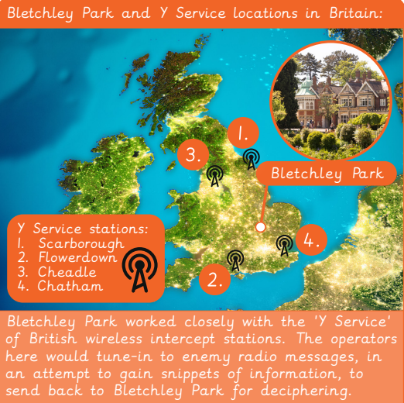
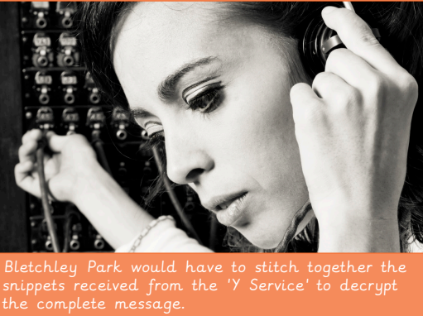
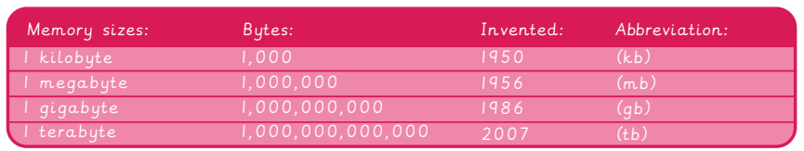
EYNESBURY KNOWLEDGE ORGANISER
KEY WORDS AND FACTS
VOCABULARY DOZEN
Background noise- A secondary sound that is there but your focus is not fully on it due to a primary sound which you are focussed on.
Byte- Made up of 8 bits. One bit contains a single binary value – 0 or 1.
Computer- Electronic machines that accept and process information.
Memory storage- A portable, compact form of digital storage, used to transfer files from one device to another.
Mouse- Handheld input device that can move and select text, icons, files and folders on your computer.
Operating system (OS)- Base software needed on a computer for it to manage basic commands.
Radio play- Scripts and written text for broadcasting on-air.
RAM- Random Access Memory A piece of hardware that allows data to be recalled or stored within a computer.
ROM- Read Only Memory. Information stored within ROM can only be read and not edited.
Sound effects- Sounds to enhance an event or bring fantasy aspects to life in a film or other media.
Touch screen- Allows the user to use their find or gestures to control the device via the screen.
Trackpad- An input device found in laptops. Use to move the cursor with the touch of a finger.
YEAR 6: Creating media- History of computers

