Slide 1
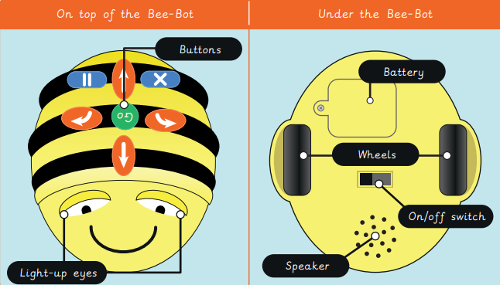
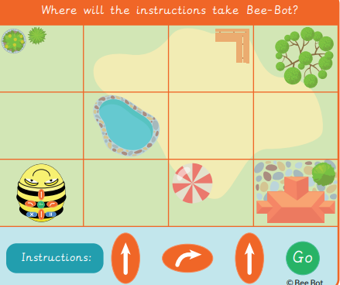
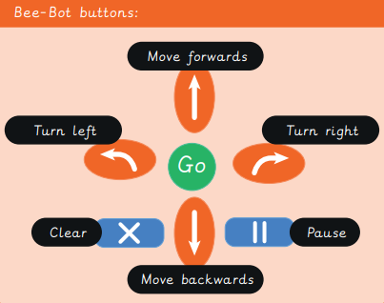
EYNESBURY KNOWLEDGE ORGANISER
KEY WORDS AND FACTS
VOCABULARY
Fact Bank
Algorithm- a clear set of instructions to carry out a task.
Bee-bot- a small programmable floor robot with seven buttons.
Computing code- words, numbers and symbols that make a computer language.
Computer program- a series of instructions, that are written for a computer to follow. Also known as apps.
Explain- give clear information about something to someone.
Explore- look at something new to learn more about it.
Instructions- a list of commands and directions on how to do something.
Predict- to make a guess.
Tinker- to explore and play with something to discover what it can do.
Video- moving picture, that make up a film or cartoon.
YEAR 1: Programming 2- Bee-bots

