Slide 1
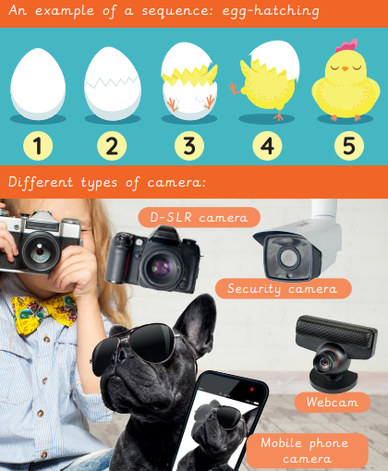

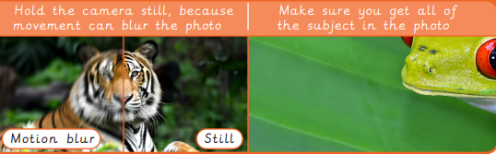
EYNESBURY KNOWLEDGE ORGANISER
KEY WORDS AND FACTS
VOCABULARY
Fact Bank
Camera- A device used to take or record pictures of people and objects.
Crop- When you change the height and/or width of an image.
Download- To save a file from the internet or another computer.
Drag and drop- When you move and place text or a file on a computer.
Editing software- Any software program that lets you change an image or video in any way.
Image- A picture.
Import- To place another file into a document, such as an image.
Search engine- A website that lets you search for information on the internet.
Smart device- An electronic device, connected to other devices on the internet.
Visual effects- The process where images are created or changed.
YEAR 1: Digital imagery

