Slide 1
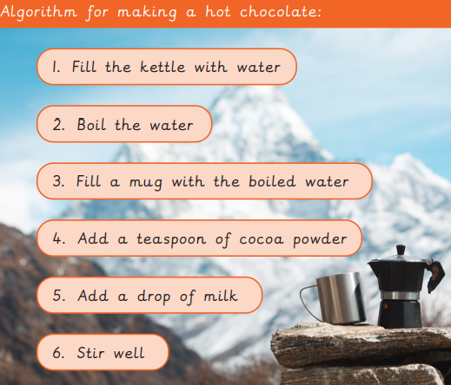

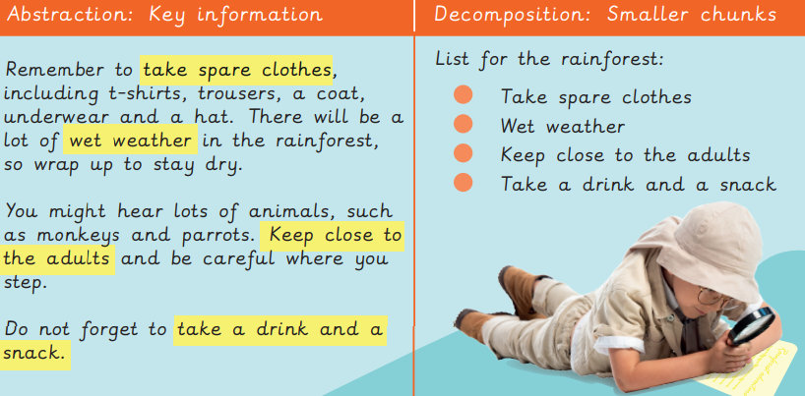
EYNESBURY KNOWLEDGE ORGANISER
KEY WORDS AND FACTS
VOCABULARY DOZEN
Abstraction- to pick out important information.
Algorithm- a clear set of instructions to carry out a task.
Artificial intelligence- computers that can perform the tasks that humans normally do.
Bug- an error or mistake in computer code.
Correct- free from mistakes.
Data- information used for a specific purpose or investigation.
Debug- to fix an error within a code.
Decompose- to break something down into smaller chunks.
Error- a mistake.
Key features- important parts of something.
Loop- a repeated sequence of instructions.
Unnecessary- not needed.
Fact Bank
YEAR 2: Programming 1- algorithms and debugging

