Slide 1
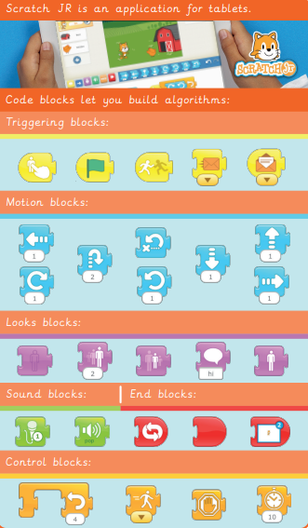
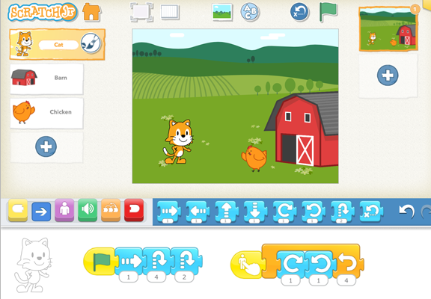
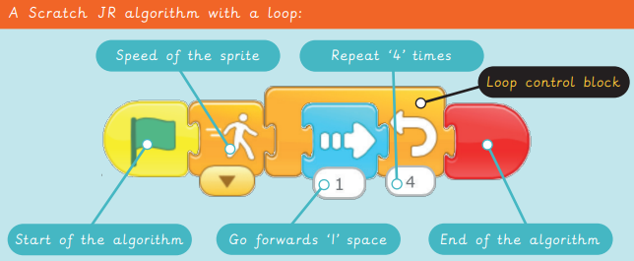
EYNESBURY KNOWLEDGE ORGANISER
KEY WORDS AND FACTS
VOCABULARY DOZEN
Fact Bank
Algorithm- a clear set of instructions to carry out a task.
Animation- Pictures or photographs in a sequence to give the illusion of movement.
Bug- an error or mistake in computer code.
Code (computer)- A set of instructions written in programming language, to tell a computer what to do.
Code (verb)- To write in programming language (code).
Debug- to fix an error within a code.
Icon- A small image which represents something or something.
Imitate- To copy.
Loop- A repeated set of instructions.
Repeat- To do the same again.
Scratch Junior- A simple, block-based coding application, in which you can instruct Scratch the cat.
Sequence- A set order or pattern for something to follow.
YEAR 2: Scratch Junior

