Slide 1
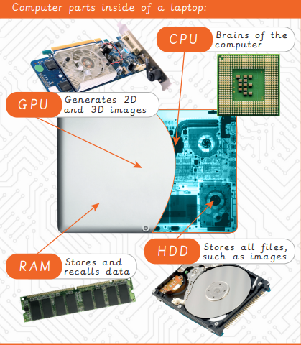
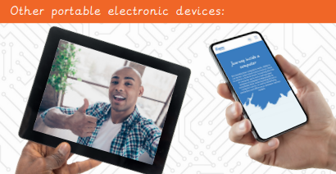

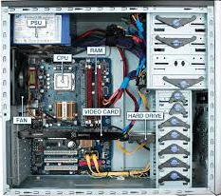
EYNESBURY KNOWLEDGE ORGANISER
KEY WORDS AND FACTS
VOCABULARY DOZEN
Algorithm- A sequence of instructions when followed, solve a problem.
Computer program- A series of instructions, written for a computer to follow. Also known as software or applications.
CPU- Central Processing Unit. The brain of a computer that deals with all the data it receives from input and output devices.
Data- Information used for a specific purpose or investigation.
Desktop- A tower computer that needs a mouse, keyboard and monitor.
GPU- Graphics Processing Unit. A piece of hardware that is used to help generate 2D and 3D images.
HDD- Hard disk drive, internal or external device that can store information such as files, documents, images and programs.
QR code- Quick response code, presented in a similar way to a bar code. When scanned takes you to a specific website.
RAM- Random access memory. A piece of hardware that allows data to be recalled or stored within a computer.
ROM- Read only memory. Information stored within ROM can only be read and not edited.
Tablet device- A handheld computer, which uses a touchscreen.
Trackpad- An input device commonly found built into laptops. It is used to move the cursor with the touch of your finger.
Fact Bank
YEAR 3: Journey inside a computer

