Slide 1
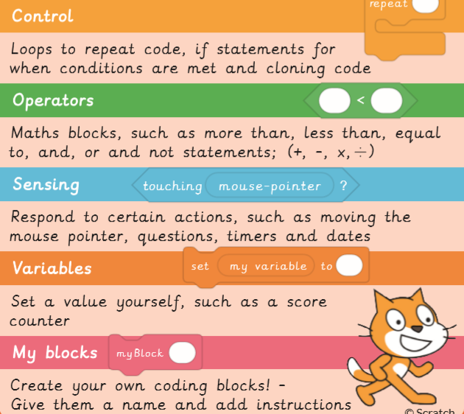
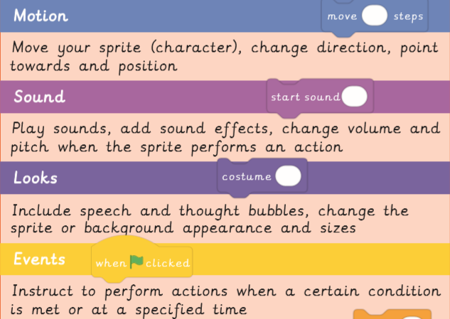
EYNESBURY KNOWLEDGE ORGANISER
KEY WORDS AND FACTS
VOCABULARY DOZEN
Code- a set of instructions written in programming language, telling a computer what to do.
Code block- a visual representation for a section of code.
Decompose- to break something down into smaller chunks.
Feature- the individual parts that make up something.
Icon- a small image which represents something or someone.
Orientation- positioning to a particular place or direction.
Program verb- to write code based instructions for a computer to process.
Position- he location of where something or someone is.
Project (Scratch)- a creation developed within the Scratch program.
Scratch- a coding program, in which you can develop interactive games and animations.
Sprite- visual objects that can be manipulated through code.
Stage- background of the Scratch project.
Fact Bank
Examples of Scratch sprites
YEAR 4: Further coding with Scratch

