Slide 1
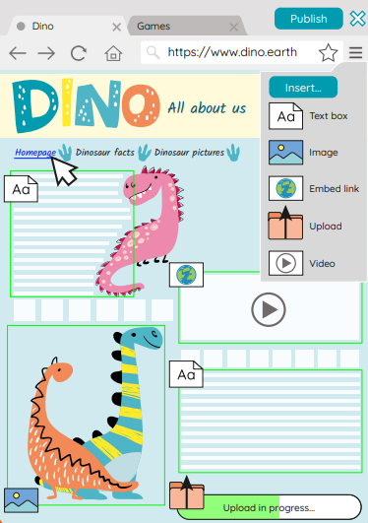
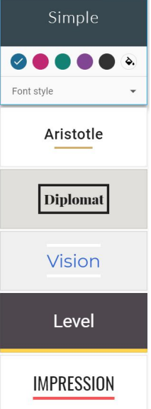
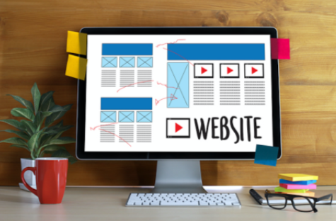
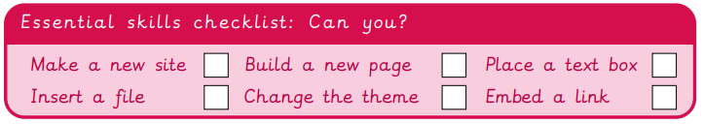
EYNESBURY KNOWLEDGE ORGANISER
KEY WORDS AND FACTS
VOCABULARY DOZEN
Content- All information and media contained in something, for example a webpage.
Design- To make, draw or write plans for something.
Edit- To change and amend something.
Embed- Media files which can be stored and viewed within a webpage.
Feature- The individual parts that make up something.
Header- Text at the top of the page.
Hyperlink- A link commonly used in a web page or document, directing you to another file or webpage.
Online- When a person is accessing the internet through an electronic device.
Tab- A way of opening and organizing multiple websites in a single window on an internet browser.
Web page- A hypertext page that can be viewed through an internet browser.
Website- A series of web pages and other content, which can be discovered and read through an internet browser.
WWW- The acronym used to express the ‘world wide web’. Found at the beginning of website addresses.
Fact Bank
YEAR 4: Website design

