Slide 1
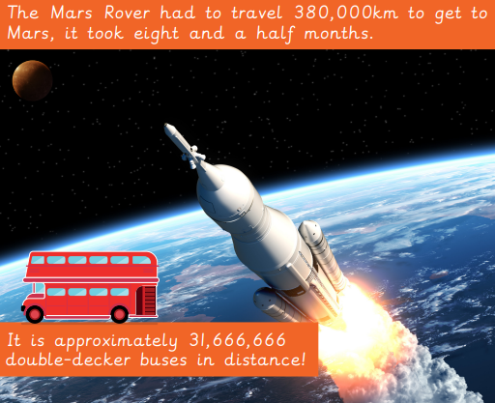
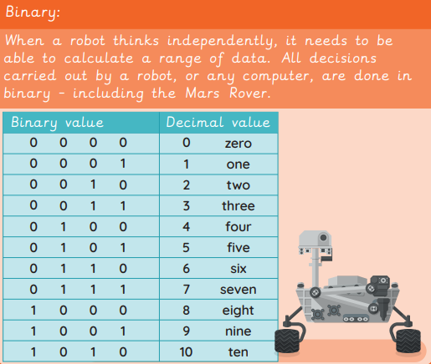

EYNESBURY KNOWLEDGE ORGANISER
KEY WORDS AND FACTS
VOCABULARY DOZEN
Binary code- a code used in computers based around the values of 0 and 1.
Data- information used for specific purpose or investigation.
Discovery- when something is found.
Input- information sent to a computer by an input device such as a keyboard or mouse.
Mars Rover- a robotic vehicle, that explores investigates and returns data about the terrain on Mars.
Numerical data- information based on numbers and digits.
Output- information or data sent by a computer to an output device such as a printer or speakers.
Radio signal- a radio wave that is sent or received somewhere.
Sequence- a st order or patterns for something to follow.
Signal- a voltage, current or electromagnetic wave that is either sent or obtained.
Computer simulation- computer generated imitation of something such as a program test or product prototype.
Space (astronomy)- a vast area around and beyond planet Earth, which is not inhabited.
Fact Bank
YEAR 5: Data handling- Mars Rover 1

