Slide 1
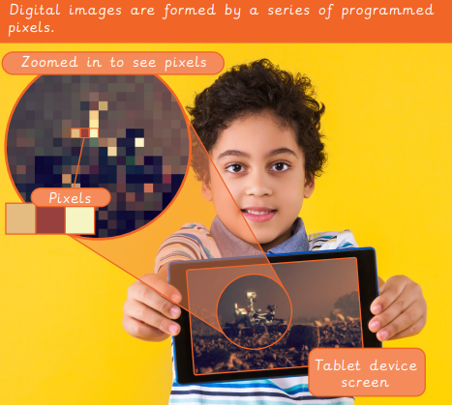
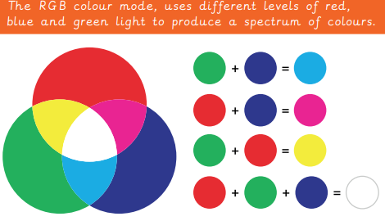

EYNESBURY KNOWLEDGE ORGANISER
KEY WORDS AND FACTS
VOCABULARY DOZEN
Algorithm- A sequence of instructions which, when followed, solve a problem.
Binary image- An image where the pixels are made up of only two colours, such as black and white.
Bit- One unit of data, that either has a value of 1 or 0. A bit is also known as a binary digit.
Bit pattern- A sequence of binary digits.
CAD- Computer- aided design, software used to create graphics, diagrams or other visuals.
Compression file- Taking single or multiple files, reducing their file size to take up less digital storage space.
CPU- Central Processing Units are the brains of a computer and deal with all of the data it receives from input and output devices.
Encode- To convert something into a different code, for someone or something else to understand it.
JPEG- Joint Photographic Experts Group. A popular image compression format.
Operating system- The base software needed on a computer for it to manage basic commands, providing a user-friendly interface.
Pixels- Screens are made up of a grid of pixels, each pixel is programmed to display a certain colour which together form an image.
RGB- Red, Green, Blue. A colour mode, that uses these three colour hues combined to create a spectrum of colours.
Fact Bank
YEAR 5: Mars Rover 2

