Slide 1
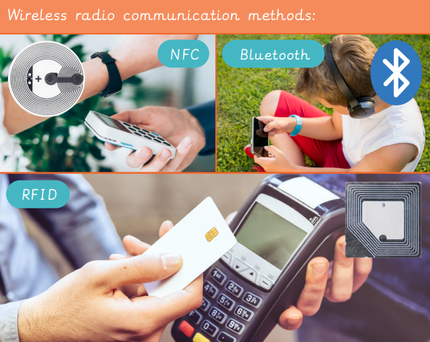
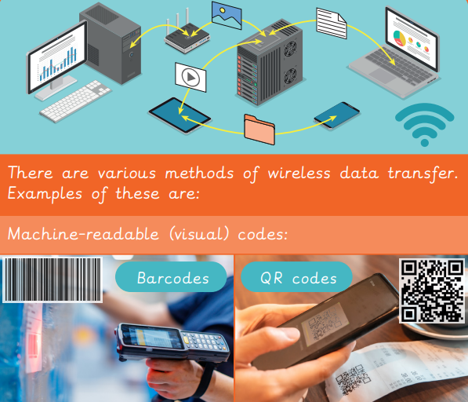
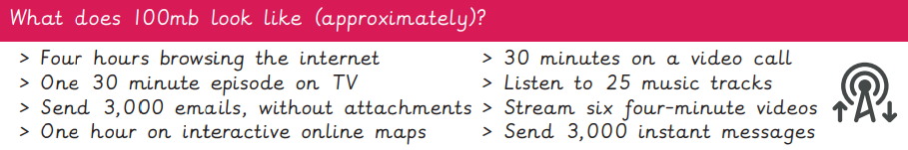
EYNESBURY KNOWLEDGE ORGANISER
KEY WORDS AND FACTS
VOCABULARY DOZEN
Big data- massive deposits of information that continue to be collected through the internet and used by data analysts.
Bluetooth- device to device connectivity, for example, sharing an image between two smart phones.
Corrupt data- when data becomes unstable, unusable or unreadable.
Digital revolution- beginning in the 1980’s, when technology began to develop from using analog to digital technologies.
GPS- Global Positioning System, designed to monitor satellite data to determine your position on Earth.
Infrared waves- the red section of the electromagnetic spectrum, which is invisible to the eye but can transmit small amounts of data.
Internet of things (IoT)- a network of smart devices around a building that collect, monitor and distribute data to work together.
QR code- Quick response code, is presented in a similar way to a bar code, when scanned will take you to a specific website.
RFID- radio frequency identification is a device that uses radio signals to check where something or someone is.
SIM- subscriber identity module, a SIM card includes a chip that stores a unique mobile number.
Computer simulation- computer generated imitation of something such as a program test or product prototype.
Smart school/city- a school or city using IoT technology to monitor and react to events.
Fact Bank
YEAR 6: Data Handling- Big Data 2

