Slide 1
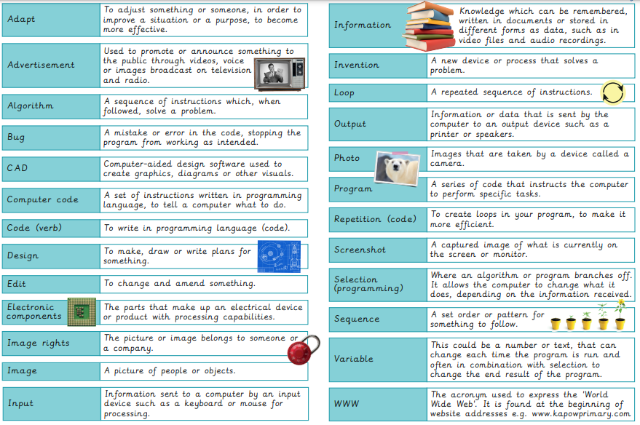
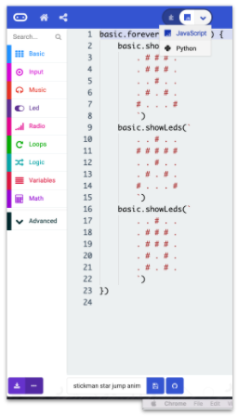
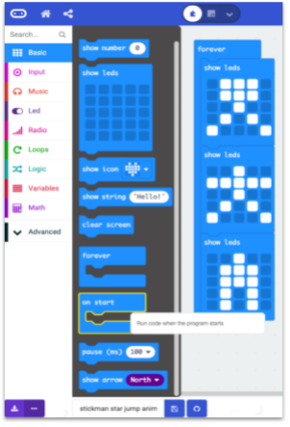
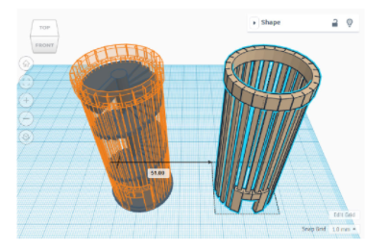
EYNESBURY KNOWLEDGE ORGANISER
KEY WORDS AND FACTS
VOCABULARY
Fact Bank- Java Script
Computer aided design
YEAR 6: Skills showcase- inventing a product

